Slide 1


Automated Man Power Allocation By Performance Analysis and Project Categorization For Construction Projects
24-25J-018

Slide 2
Team Members
IT Number | Name
IT21270956 | Munagama M.K.H
IT21276750 | Isuranga K.M.S
IT21069840 | Devashika R.P.P.A
IT21087660 | Perera K.M

Slide 3
Supervisors
 | Name
Supervisor | Ms.Buddima Attanayake
CO-Supervisor | Ms.Narmada Gamage
External Supervisor | Mr.Darshana Senevirathne

Slide 4

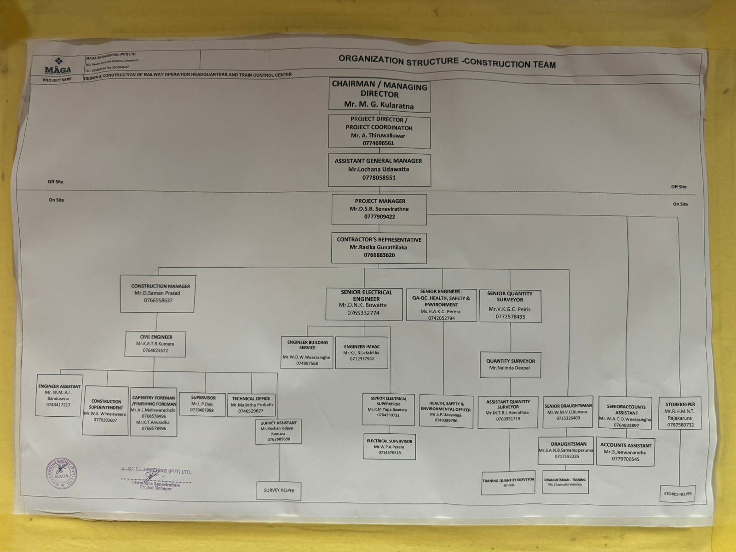
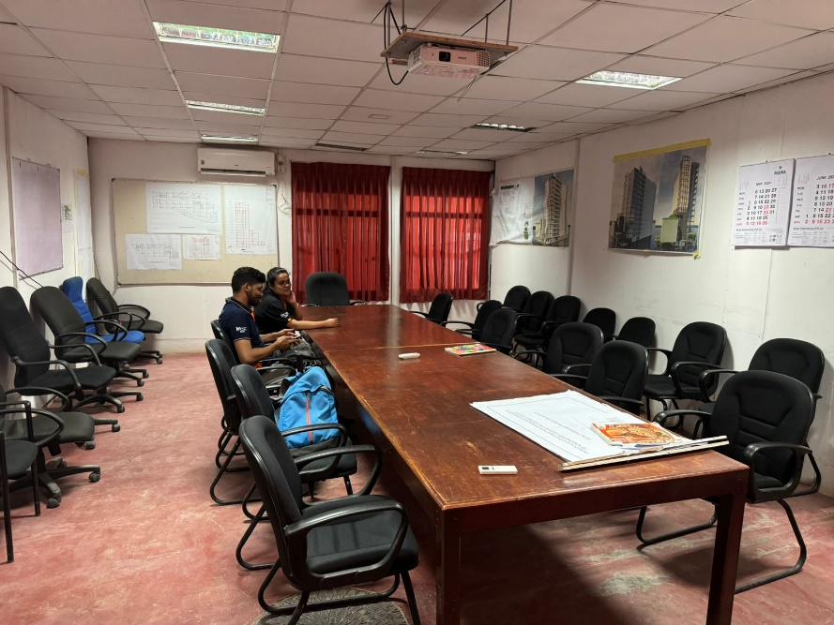
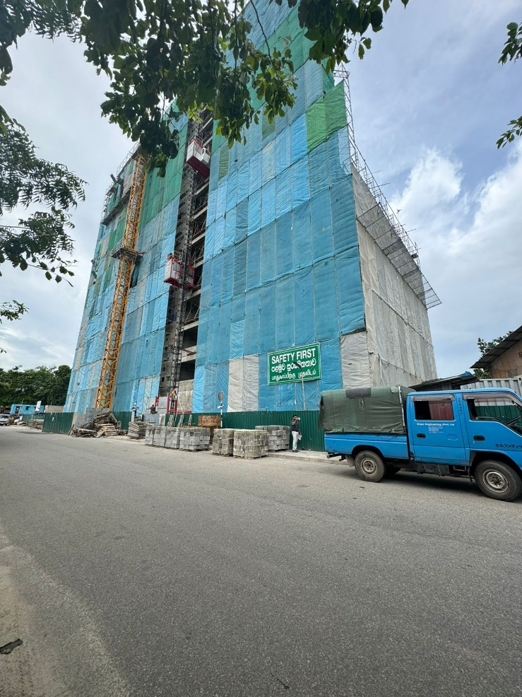
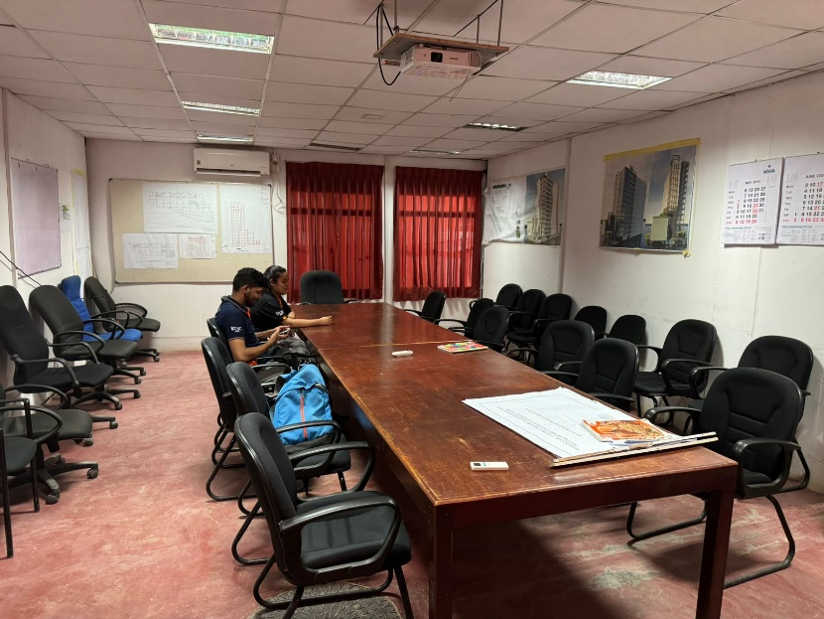
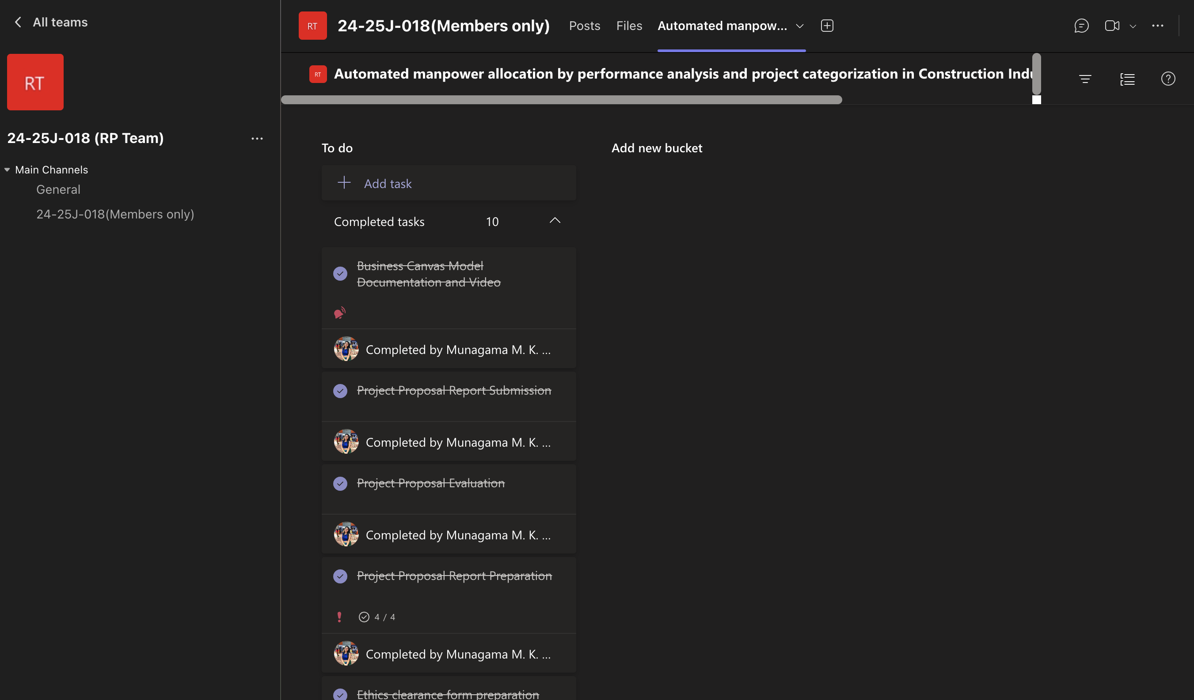
Evidences

Slide 5

Introduction
Manpower required in construction projects are in 2 types;
Employees in the Company
Ex: Civil Engineers,Technical Officers,Surveyors etc.
2. Laborers work in the site
Ex:Carpentors,Masons,Painters etc.
Our client : MAGA Engineering PVT LTD
Types of construction projects in MAGA;
Buildings
Highways & Bridges
Water, wastewater
Irrigation

Slide 6

Research Problem
"How does improper manpower allocation based on project managers' experience affect efficiency and project outcomes in the construction projects?”

Slide 7

Main Objective
"Develop a system to generate employee KPIs based on experience and performance, categorize projects by complexity and risk, optimally allocate suitable employees, and predict the required number of laborers for future projects."

Slide 8
Sub Objectives
Project Categorization.
KPI Value generation by performance analysis and CV analysis.
Employee allocation and Optimization.
Prediction of labor, cost and timeline.

Slide 9



Research Gap
Real time predictive analysis of project
Applicable for construction Projects
KPI based manpower allocation
Labor requirement Prediction
Application
Reference
Web Application
Project Categorization
Procore
Primavera P6
nPlan
BuildTrend
Project Pulse

Slide 10


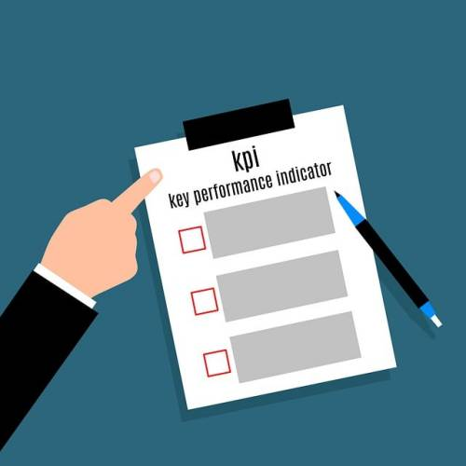


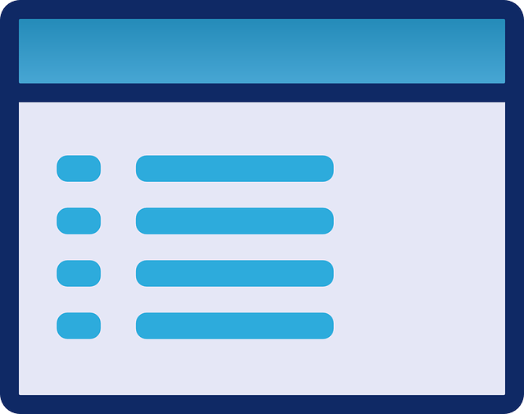









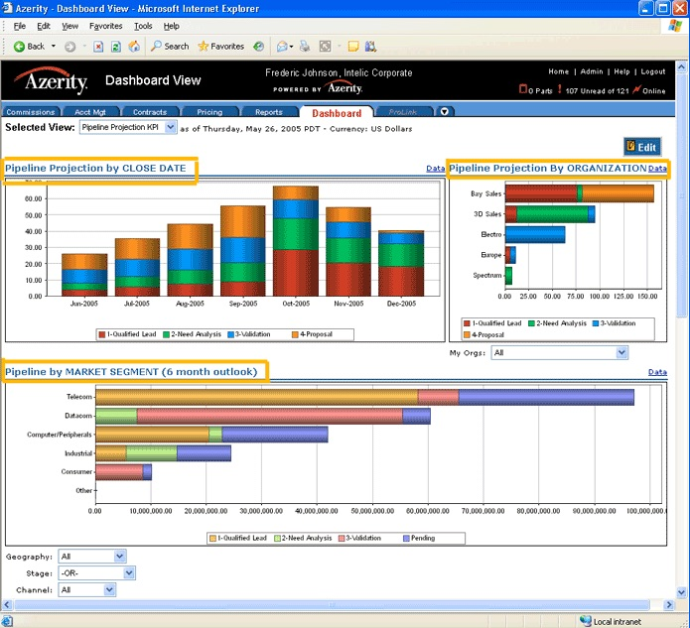

KPI Generation by CV detail analysis and Performance analysis
2
Storing CV details in the Database
Updating the KPI of employees according to the experience
1
Project Categorization
Employee CV Upload
Initial KPI Generation
Classifying Projects According to Criteria
Update KPI
Project Categorization
TimeFrame
Budget Level
Risk Level
Complexity
Geographical Factors
Environment Impact (Low,Medium,High)
Enters Upcoming Project Details
Projects Classification
KPI Value as a Percentage
HR Department
Allocated details of the employee
Project Manager
Labor,Cost and Timeline Prediction
Data Processing and Analysing
Labor Prediction on
Project Size and Completion days
Recording the Daily Tasks and Labor Attendance
Employee allocation and Optimization
Enters Daily Attendance and Tasks
3
Matching the KPI with Project Complexity
Predicting Cost and Timeline
4
Suggestions of the employees in order to select as per the requirement
Dashboard

Slide 11

IT21087660|Perera K.M
BSc(Hons)in Information Technology specialized in Information Systems Engineering
Project Categorization.
IT21067660 | Perera K.M | 24-25J-018

Slide 12


Overview Diagram
Project Manager
Classifying Projects According to Criteria
Project Categorization
Risk Level
Complexity Fa (Low,Medium,High)
Enters Upcoming Project Details
Project Type
Scope
Objectives
Location
Budget
Duration
Site Conditions
Projects Classification
IT21067660 | Perera K.M | 24-25J-018

Slide 13

Progress 100% Completion
Developed a system to enter upcoming project details.
Classified projects according to specific criteria.
Created a standardized method for categorizing projects based on risk and complexity using details like type, scope, objectives, location, budget, timeline, and site conditions.
Implemented project classification based on risk level, complexity, geographical factors, and environmental impact.
Used Decision Tree Regressor and other models to analyze project risk and complexity.
Data gathered from MAGA Engineering Pvt Ltd.
Application reference to tools like Procore, Primavera P6, nPlan, Microsoft Project.
IT21067660 | Perera K.M | 24-25J-018

Slide 14
Importance & Industry Benefits:
Enables automatic classification of construction projects, improving project planning and resource allocation.
Helps assess environmental impact and geographical considerations effectively.
Facilitates risk level and complexity assessment that supports better project management.
Supports integration with existing project management tools for real-time decision-making.
Reduces manual errors and reliance on subjective project manager experience.

Slide 15
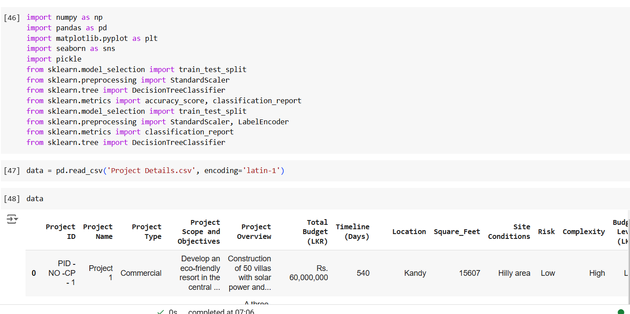
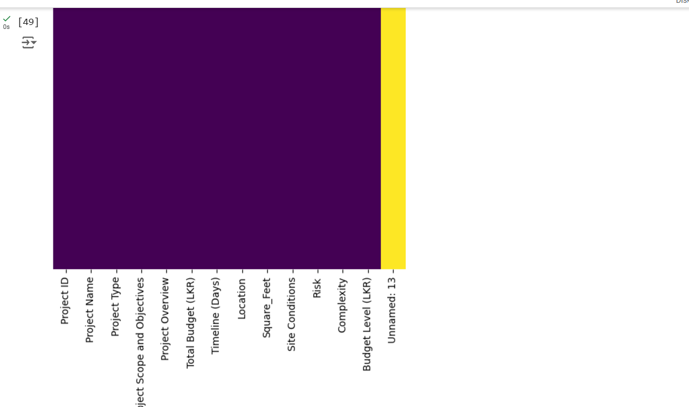
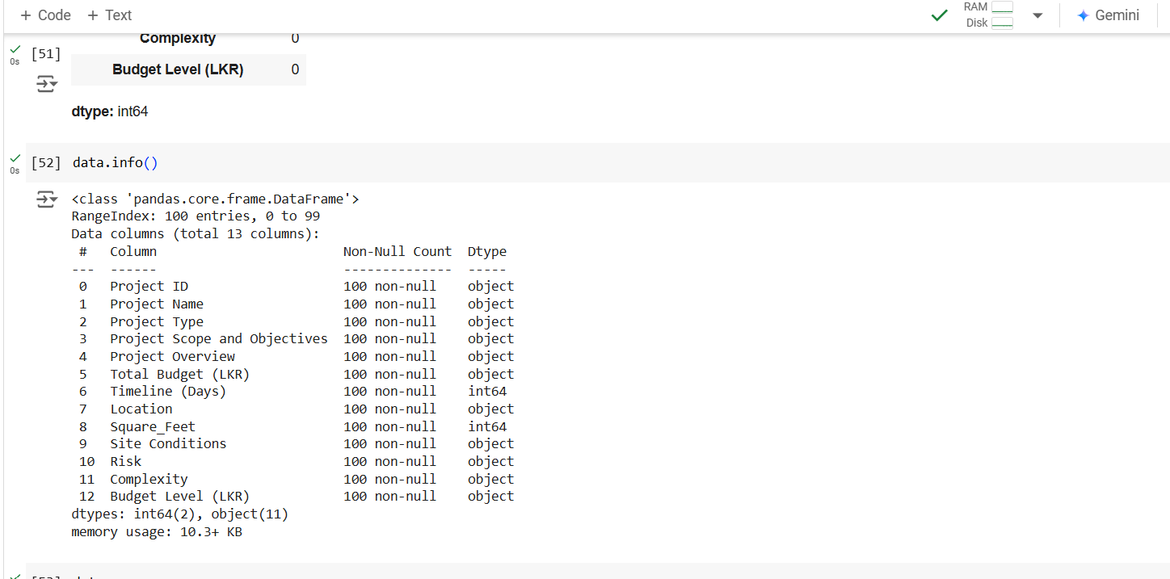
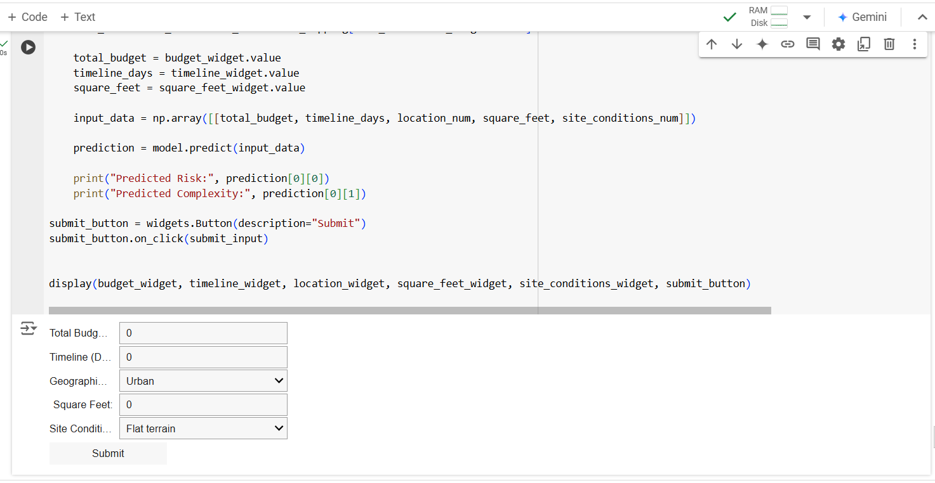
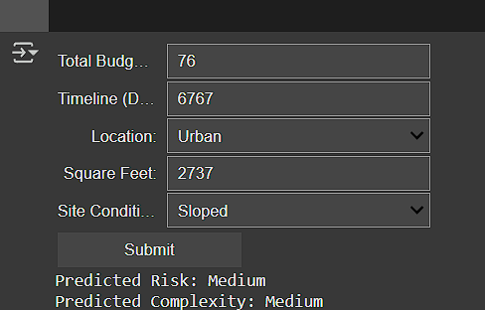
Project Evidence
IT21067660 | Perera K.M | 24-25J-018

Slide 16
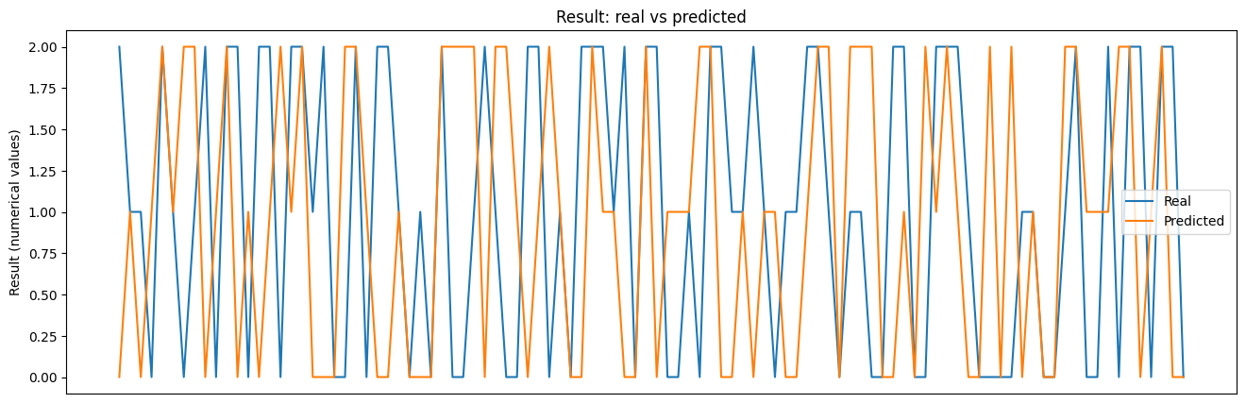
Project Evidence
Decision Tree (Both Risk and Complexity)
IT21067660 | Perera K.M | 24-25J-018

Slide 17
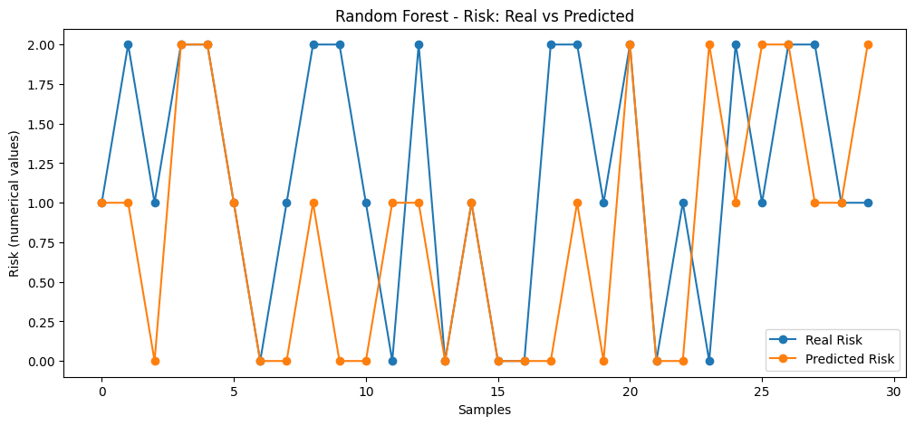
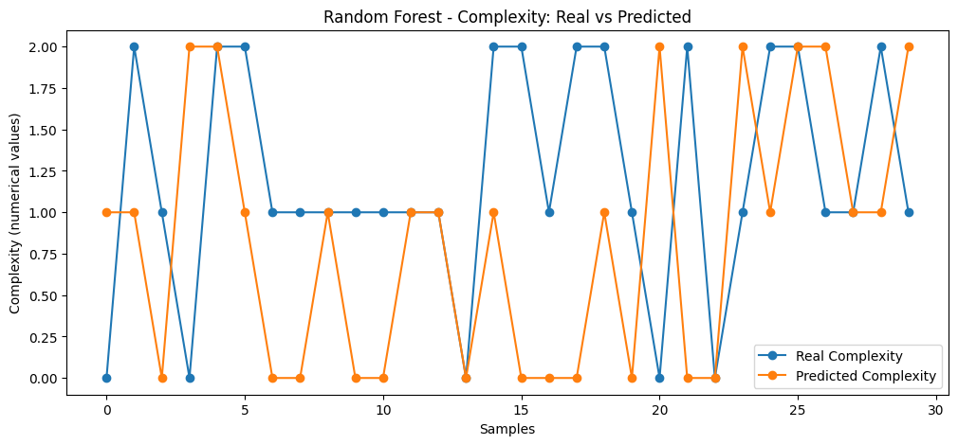
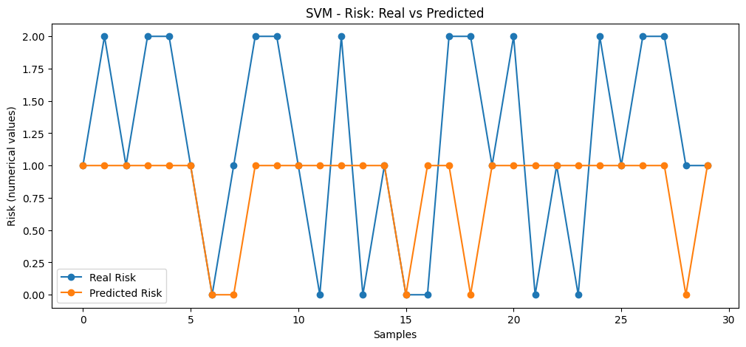
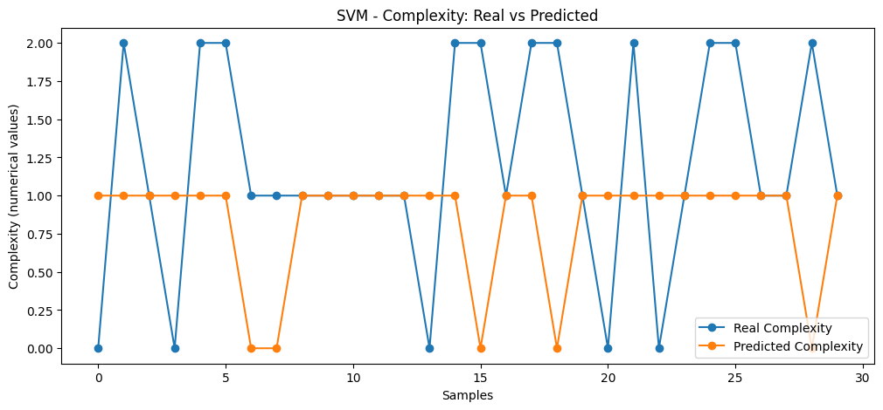
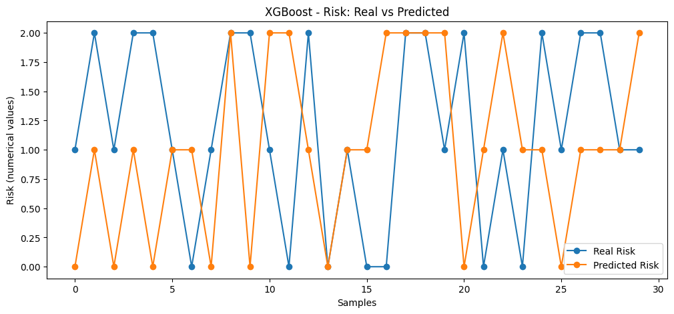
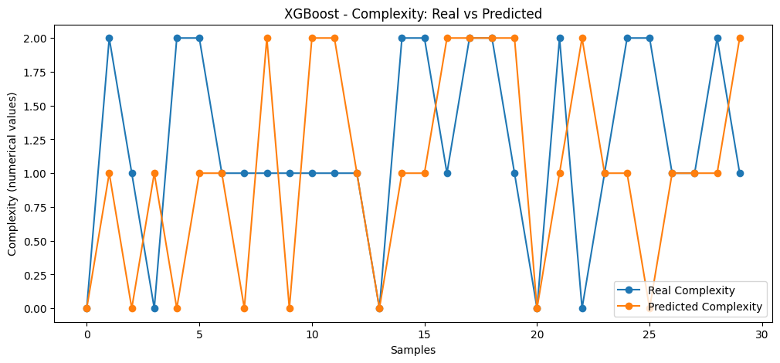
Project Evidence
Random Forest
SVM
XGBoost

Slide 18

IT21276750|Isuranga K.M.S
BSc(Hons)in Information Technology specialized in Information Systems Engineering
KPI Generation by Performance analysis and CV analysis.
IT21276750 | Isuranga K.M.S | 24-25J-018

Slide 19

Overview Diagram
IT21276750 | Isuranga K.M.S | 24-25J-018

Slide 20


HR Department
Updating the KPI of employees according to the experience
Update existing KPI
Allocated details of the employee
KPI Value as a Percentage
Employee CV
Initial KPI Generation
Storing CV details in the Database
IT21276750 | Isuranga K.M.S | 24-25J-018

Slide 21
Progress (100% Completion):
Developed an upload portal for employee CVs.
Generated initial KPI values from CV data.
Stored CV details and KPI values in a database.
Developed functionality to update KPIs based on employee experience and performance.
Calculated KPI values as percentages for better comparison.
Applied Natural Language Processing (NLP) and Multi-Nominal Naive Bayes algorithm for analysis.
Trained models including Random Forest and Decision Tree Regression with decent accuracy.
Data sourced from MAGA Pvt Ltd.
References to industry tools like SAP Success Factors, Workday, BambooHR.
IT21276750 | Isuranga K.M.S | 24-25J-018

Slide 22
Importance & Industry Benefits:
Automates employee KPI generation, improving accuracy and timeliness.
Facilitates real-time KPI updates for better HR and project management decisions.
Reduces challenges related to physical CV management and outdated KPI systems.
Supports objective employee performance measurement and better manpower planning.
Integration with HR systems enhances operational efficiency and talent management.

Slide 23
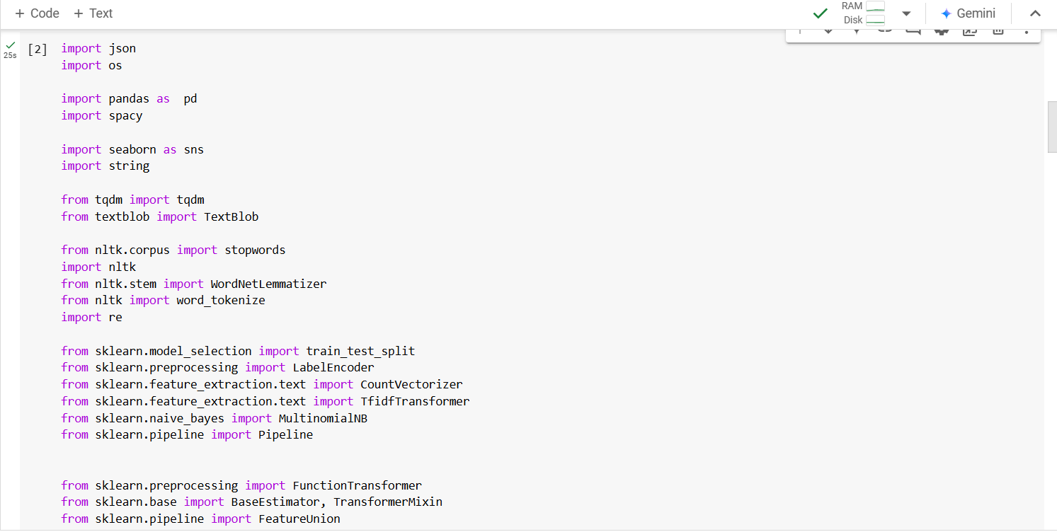
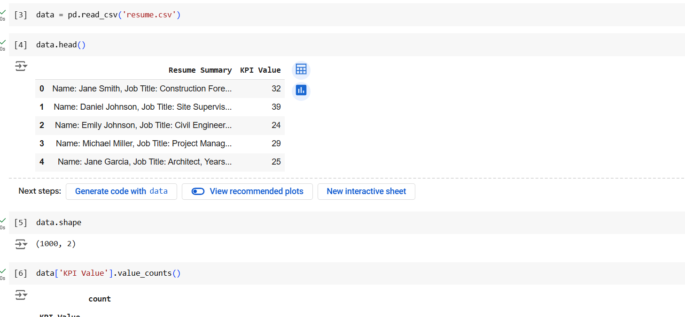
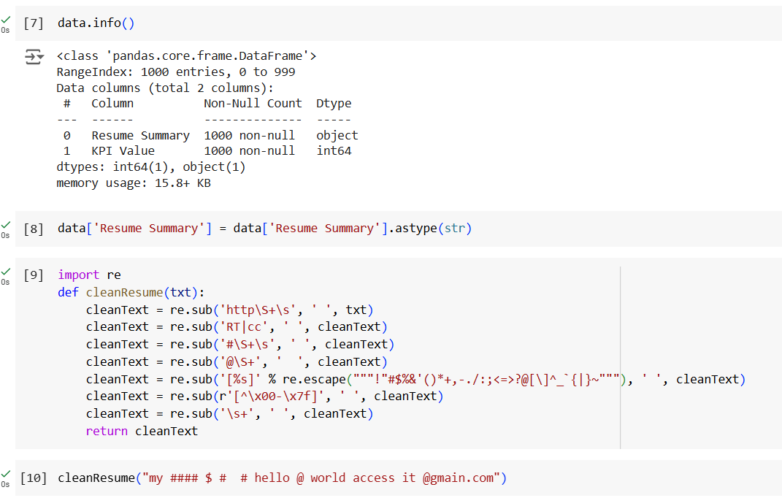
Project Evidence (PP1)
IT21276750 | Isuranga K.M.S | 24-25J-018

Slide 24
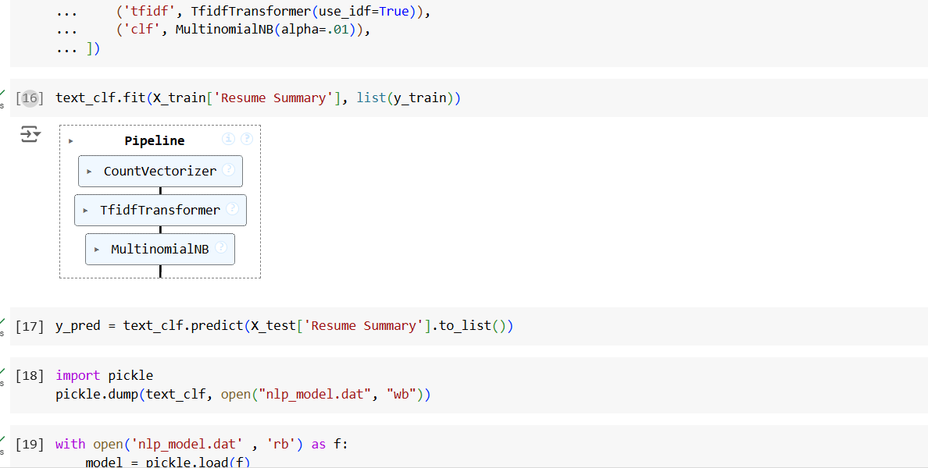
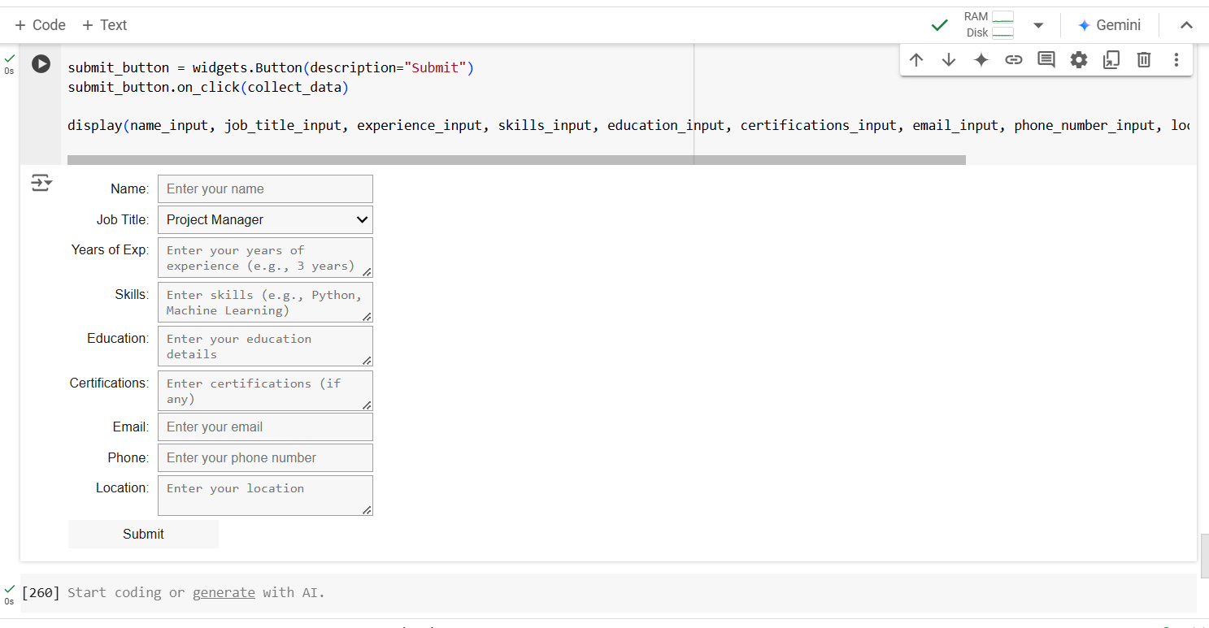
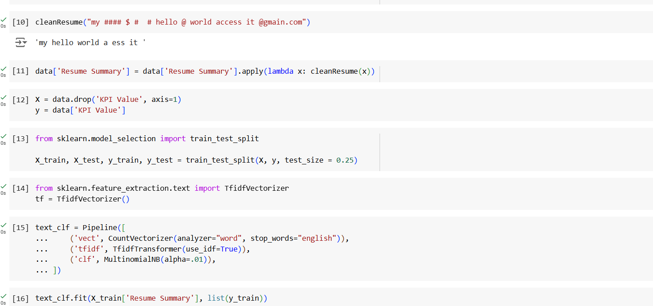
Project Evidence (PP1)

Slide 25
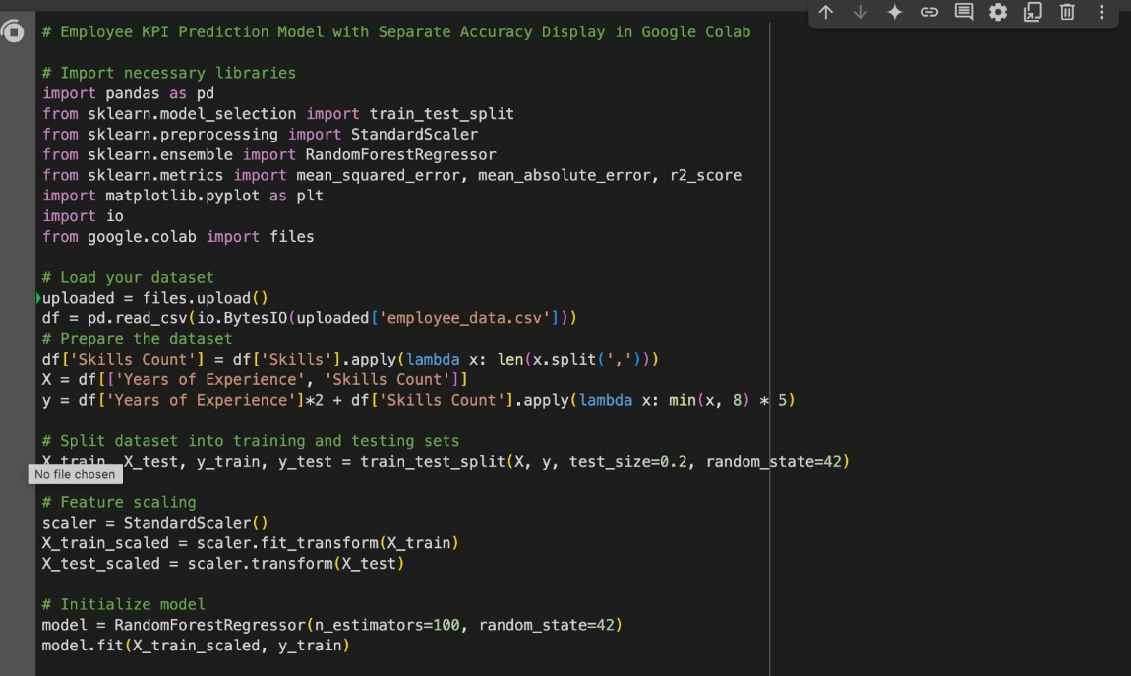
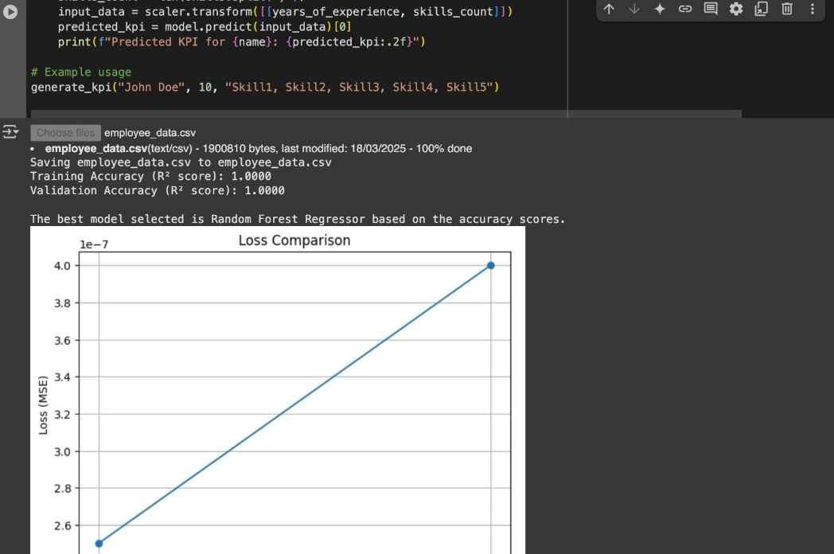
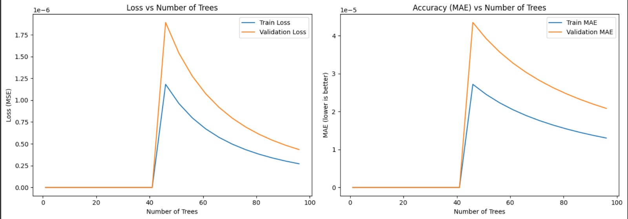
Decision Tree Regression
Accuracy Score : 0.75
Trained Models
Random Forest Regression
Accuracy Score:1

Slide 26
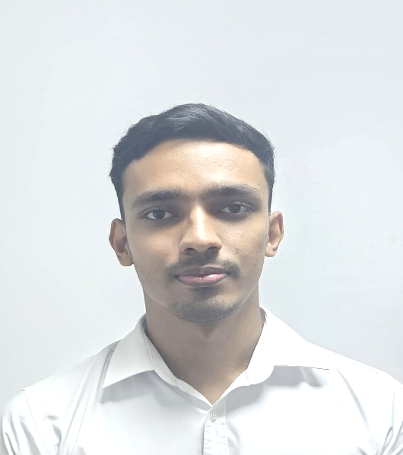
IT21069840|Devashika R.P.P.A
BSc(Hons)in Information Technology specialized in Information Systems Engineering
Employee Allocation and Optimization.
IT21069840 | Devashika R.P.P.A | 24-25J-018

Slide 27
Overview Diagram
Project Categorization
TimeFrame
Budget Level
Risk Level
Complexity
Geographical Factors
Environment Impact (Low,Medium,High)
KPI Value as a Percentage
Project Manager
Matching the KPI with Project Categorization Results
Suggestions of the employee IDs in order to select as per the requirement
IT21069840 | Devashika R.P.P.A | 24-25J-018

Slide 28

Progress (100% Completion):
Developed a model to match employees to projects using generated KPIs and project categorization results.
Created suggestions for project managers on suitable employee selections.
Validated allocation models with historical data and real-world scenarios.
Implemented KPI percentage calculation for employee allocation.
Used Decision Tree Regressor models and technologies like Python, ReactJS, NodeJS, and MySQL.
Gathered data on number of employees working on projects and required employee categories.
Application reference to tools like Procore, Primavera P6, BuildTrend, ALICE Technologies, and PlanGrid.
IT21069840 | Devashika R.P.P.A | 24-25J-018

Slide 29
Importance & Industry Benefits:
Improves efficiency by optimizing manpower allocation based on objective KPIs.
Reduces inefficiencies caused by subjective allocation based on experience alone.
Enhances project outcomes through better alignment of employee skills with project complexity.
Supports systematic employee management and workload balancing.
Facilitates data-driven decision-making in HR and project planning.
IT21069840 | Devashika R.P.P.A | 24-25J-018

Slide 30
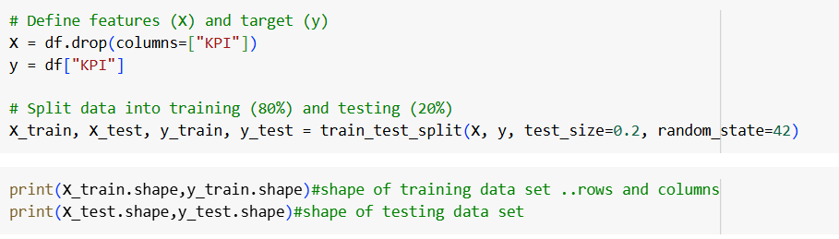
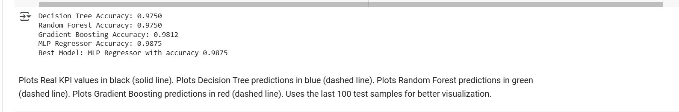
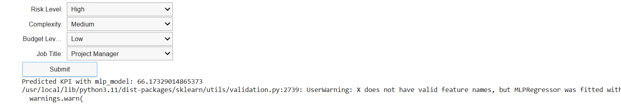
Project Evidence
IT21069840 | Devashika R.P.P.A | 24-25J-018

Slide 31
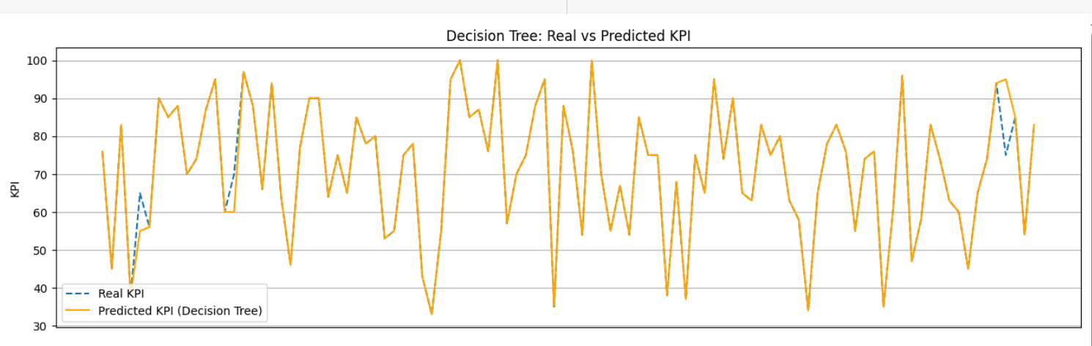
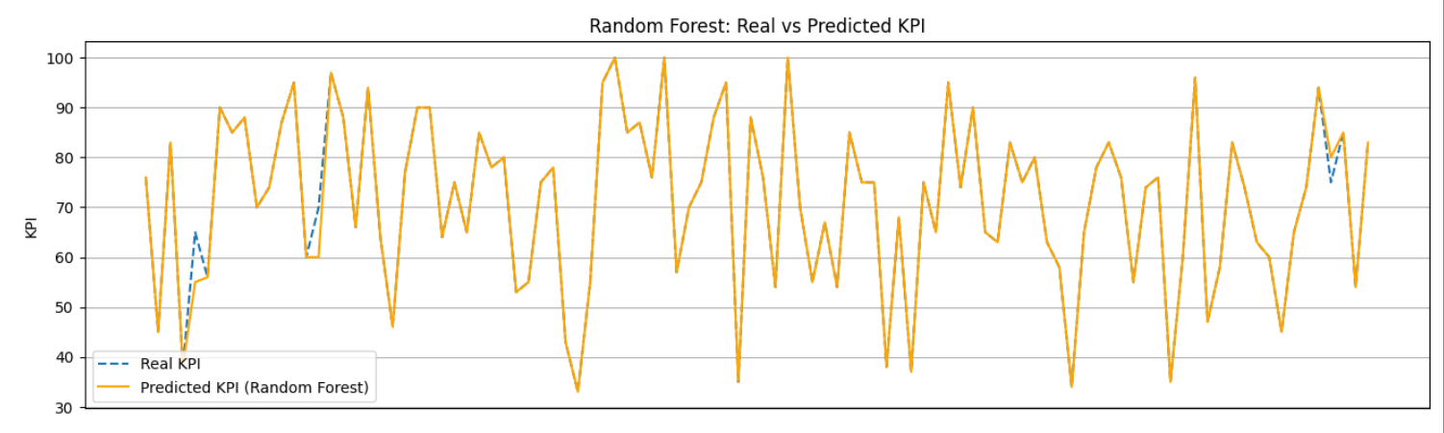
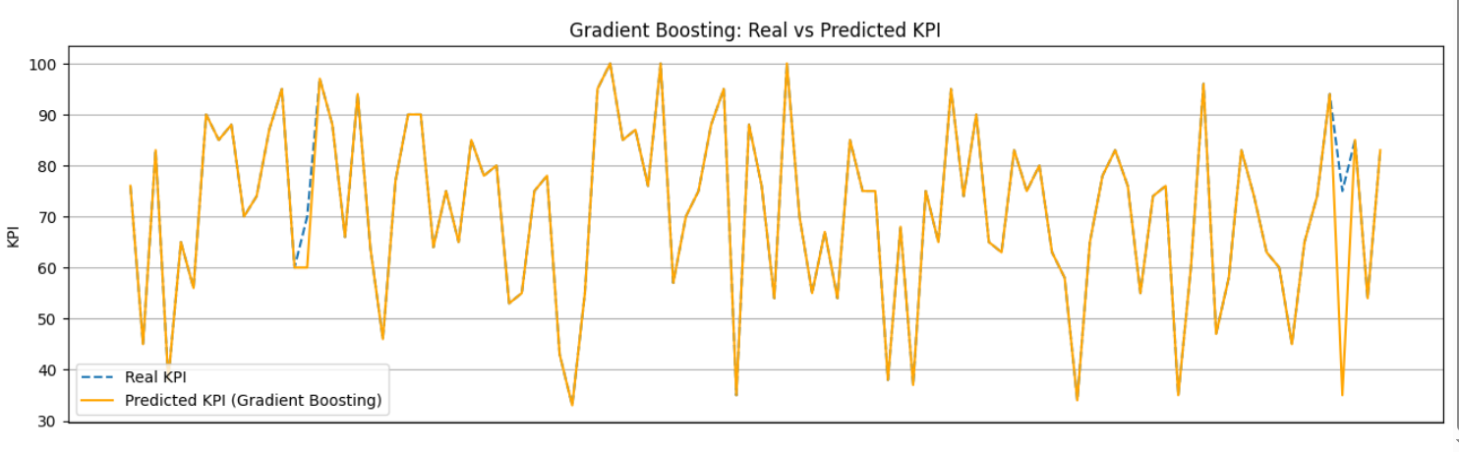
Project Evidence
IT21069840 | Devashika R.P.P.A | 24-25J-018

Slide 32
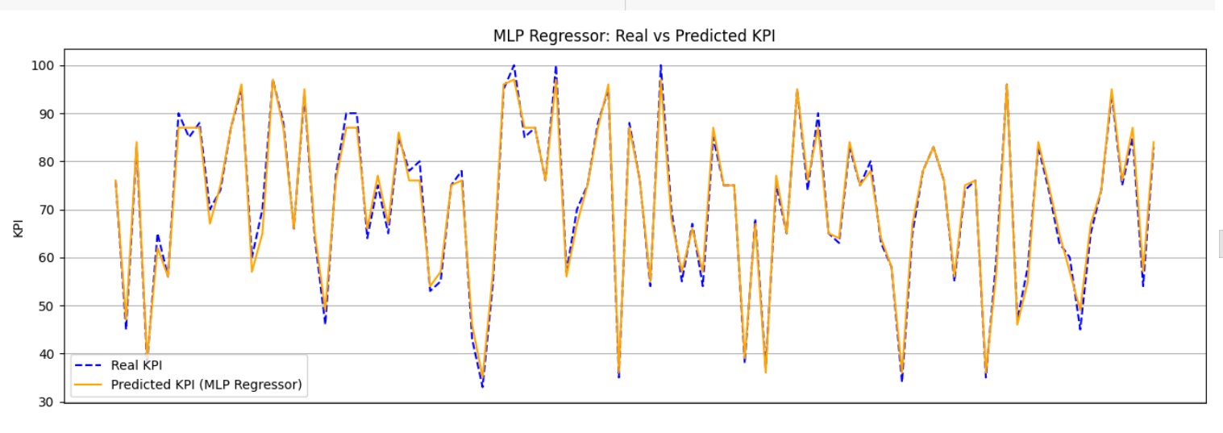
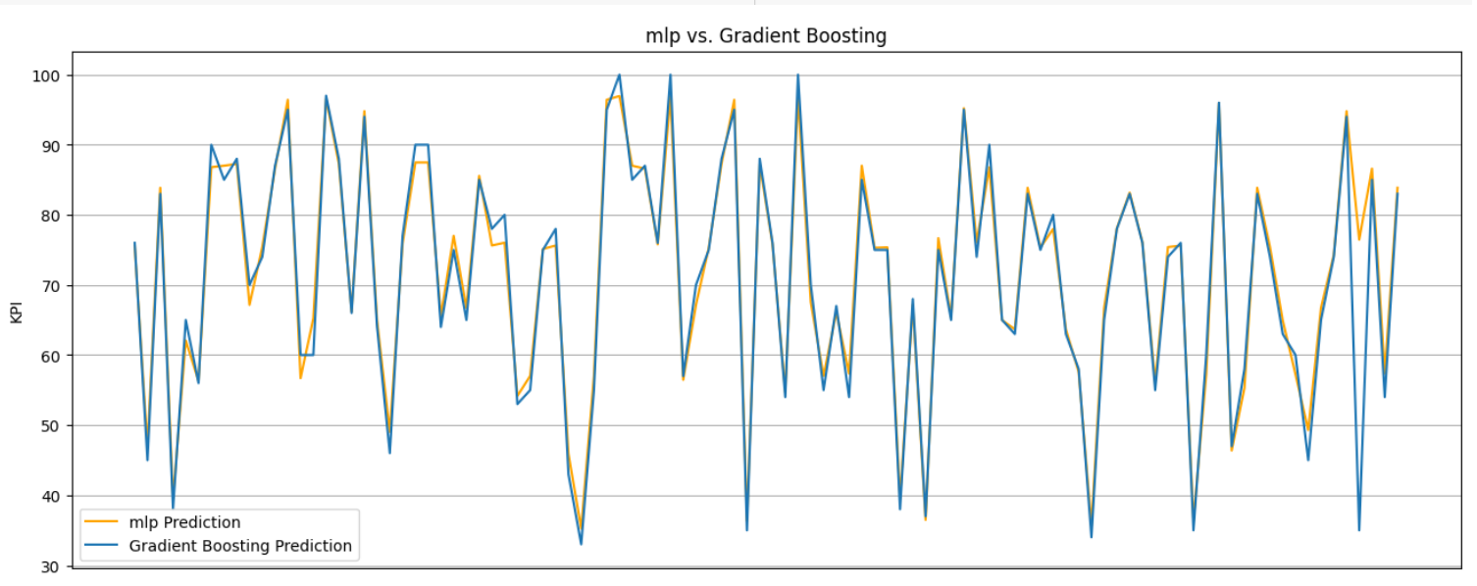
Project Evidence
IT21069840 | Devashika R.P.P.A | 24-25J-018

Slide 33
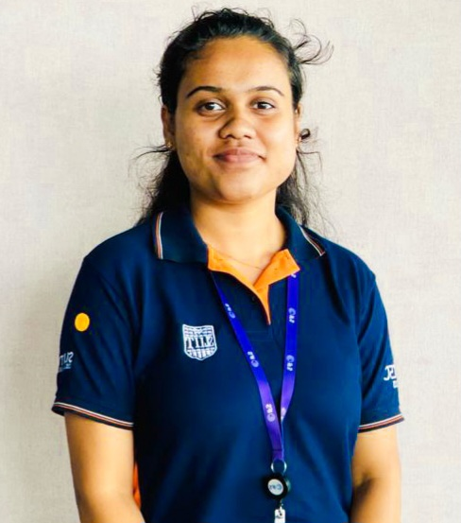
IT21270956|Munagama m.k.h
BSc(Hons)in Information Technology specialized in Information Systems Engineering
Labor, cost and timeline prediction.
IT21270956 | Munagama M.K.H | 24-25J-018

Slide 34
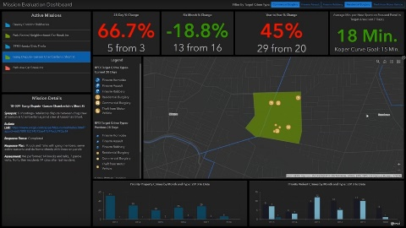
Overview Diagram
Project Manager
Recording the Daily Tasks and Labor Attendance
Enters Daily Attendance and Tasks
Predicting Cost and Timeline
Dashboard
Labor Prediction on Project Categorization
Project Categorization
TimeFrame
Project Size
IT21270956 | Munagama M.K.H | 24-25J-018

Slide 35

Progress (100% Completion):
Analyzed past project details to train labor, cost, and timeline prediction models.
Created a platform to update daily labor attendance and completed tasks.
Developed predictive models (Decision Tree Regression, Random Forest, Deep CNN) with accuracy scores for labor count and project timeline.
Considered additional parameters like number of floors, windows, and doors in labor predictions.
Integrated technologies like Python, ReactJS, NodeJS, MySQL, and Power BI for dashboards.
Data collected from MAGA Pvt Ltd on budget, timeline, labor categories, and labor histograms.
Provided real-time project status prediction capabilities.
IT21270956 | Munagama M.K.H | 24-25J-018

Slide 36
Importance & Industry Benefits:
Helps forecast labor requirements accurately, reducing under- or over-staffing.
Enables better budgeting and timeline management, reducing project delays and cost overruns.
Supports real-time monitoring of labor and task progress for proactive management.
Enhances transparency and accountability in construction projects.
Integrates with dashboard tools to provide actionable insights to project managers.

Slide 37
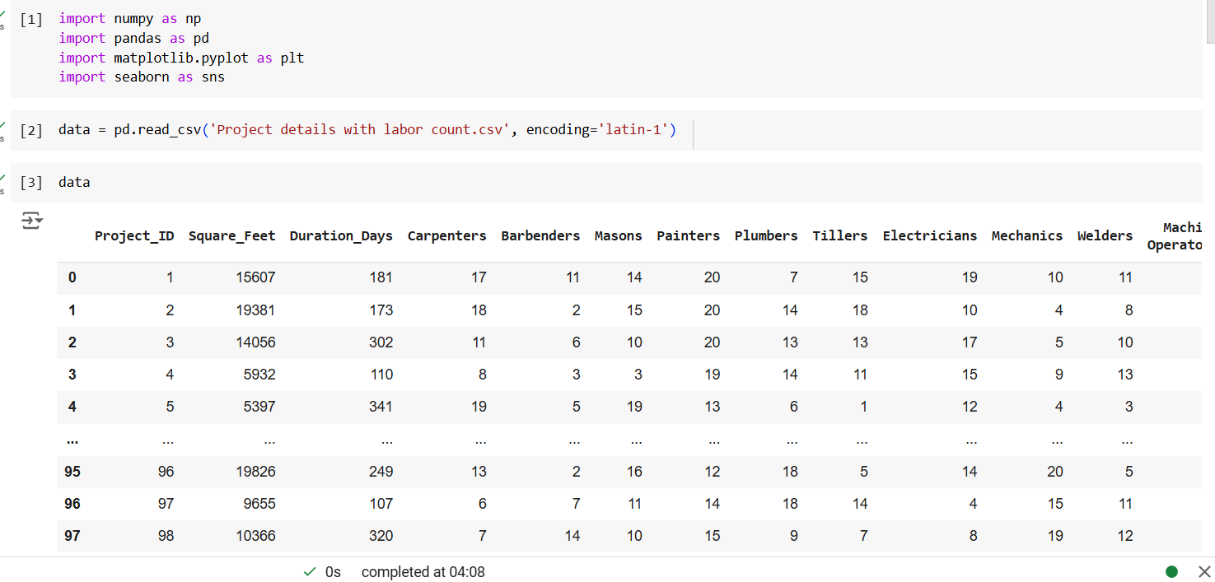
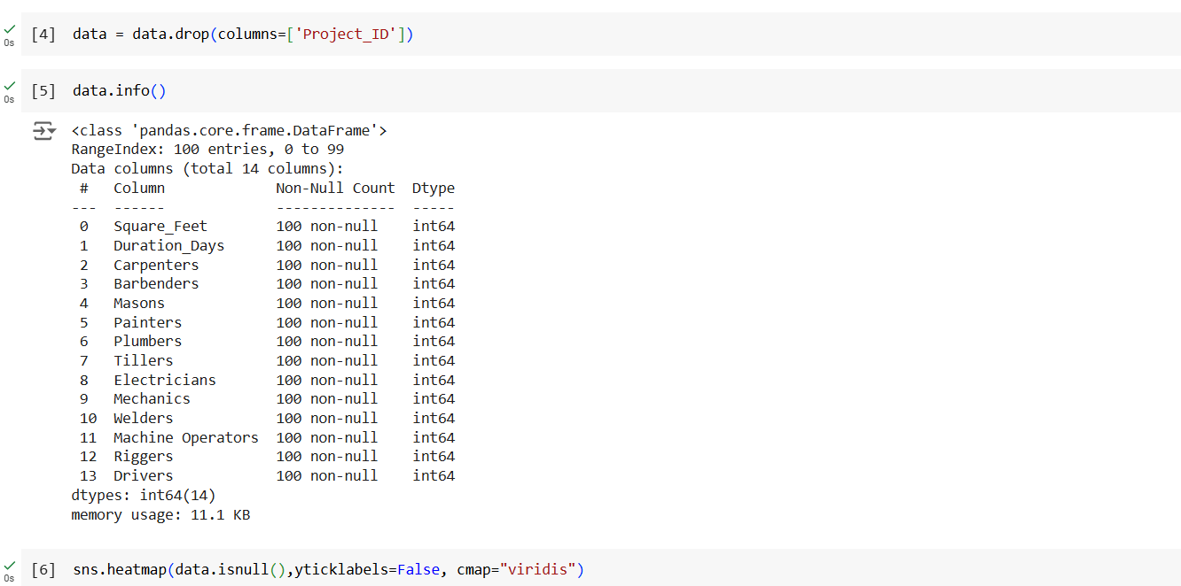
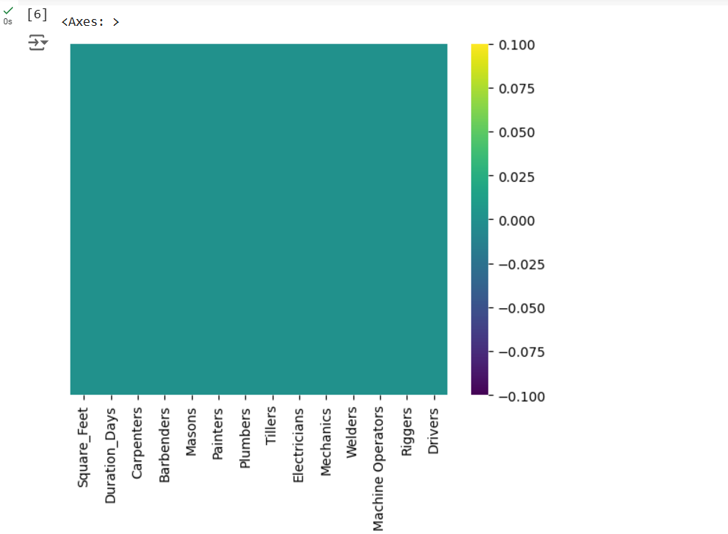
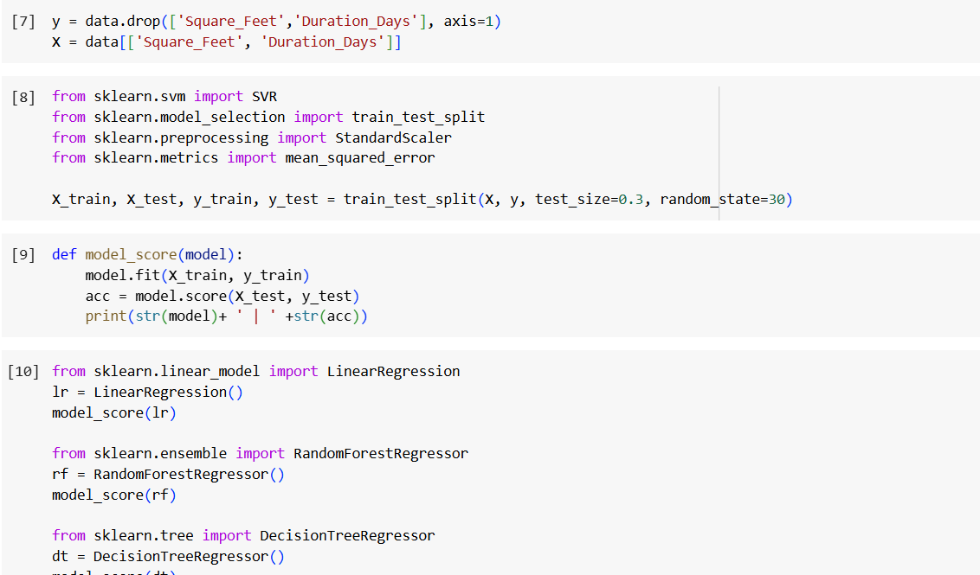
Project Evidence (PP1)
IT21270956 | Munagama M.K.H | 24-25J-018

Slide 38
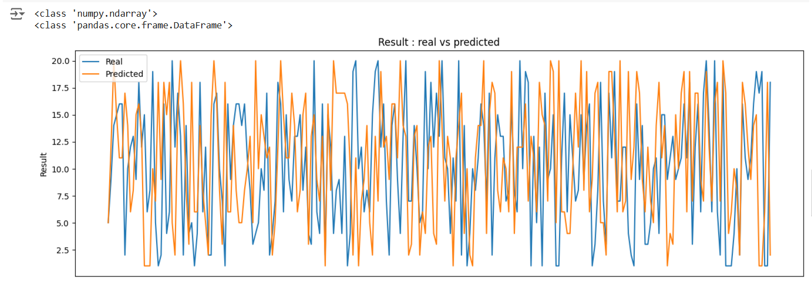
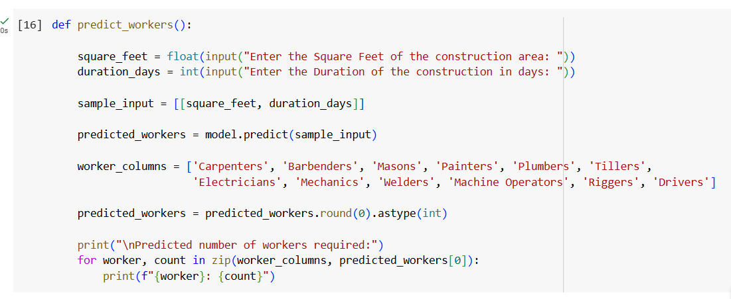
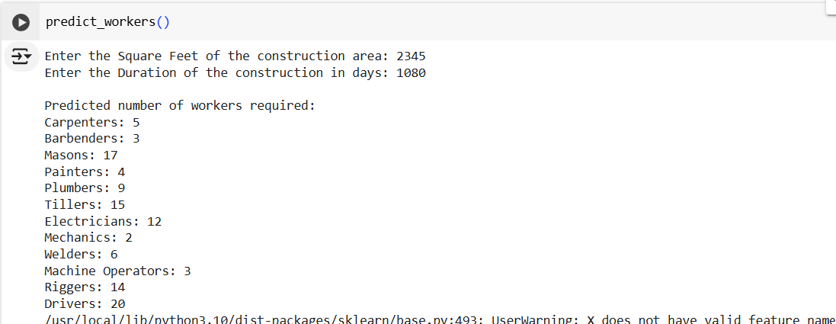
Project Evidence (PP1)
IT21270956 | Munagama M.K.H | 24-25J-018

Slide 39
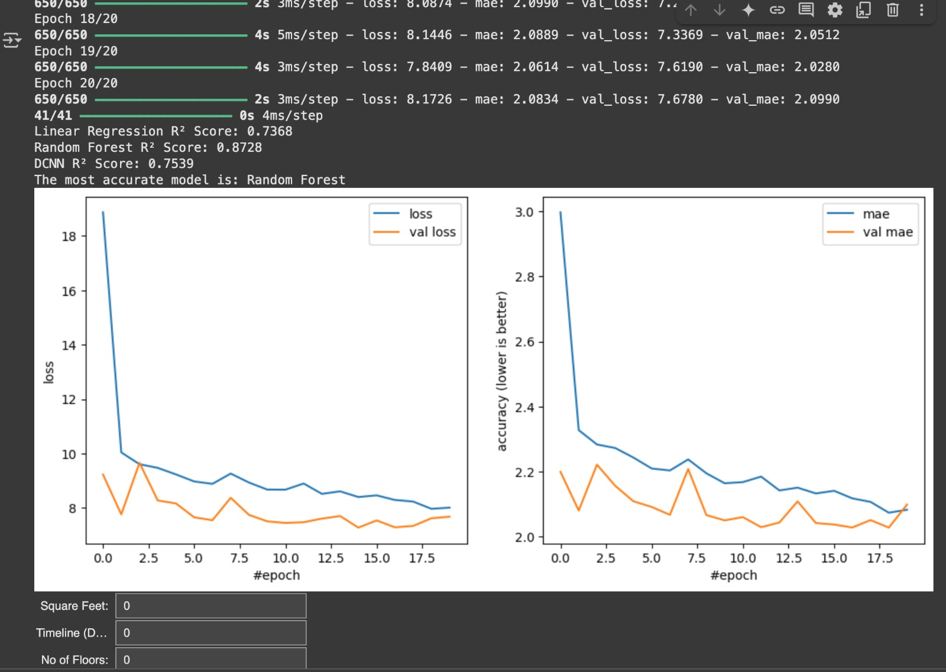
Trained Models
Deep Convolutional Neural Network
Accuracy Score : 0.7539
Linear Regression
Accuracy Score : 0.7368
Random Forest Regression
Accuracy Score : 0.8728
IT21270956 | Munagama M.K.H | 24-25J-018

Slide 40
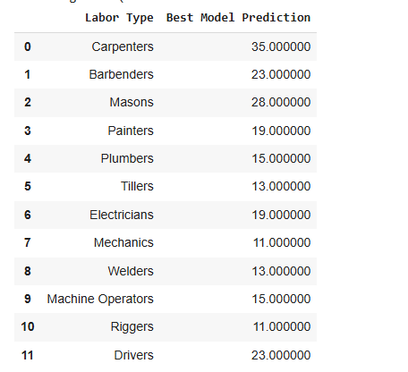
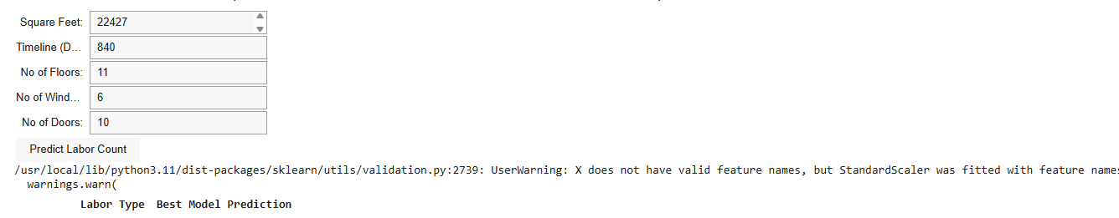

Slide 41
Commercialization and Entrepenuership
Data Quality and Availability: Access to comprehensive, accurate, and updated project and employee performance data remains a challenge.
Integration Complexity: Seamless integration with diverse existing construction and HR management software requires significant customization.
User Adoption: Resistance from traditional project managers and HR personnel accustomed to manual processes could slow adoption.
Scalability Issues: Scaling the solution to accommodate very large projects or multinational companies may require advanced infrastructure.
Dynamic Project Environments: Construction projects often change rapidly, requiring the system to adapt in near real-time.
Model Accuracy: Maintaining and improving AI model accuracy with evolving data and project types needs ongoing training and validation.
Security and Privacy: Handling sensitive employee and project data necessitates strong security protocols and compliance with regulations.
Cost of Implementation: High upfront costs and training requirements could be a barrier for smaller companies.

Slide 42
Feedbacks from User Acceptance Testing
UAT Done with our external Supervior Mr.Darshana Senevirathna (Project Manager) of MAGA Enginnering Pvt Ltd.
Click_Here

Slide 43
Demonstration

Slide 44

Q&A?

Slide 45

Thank You

